Slide 1
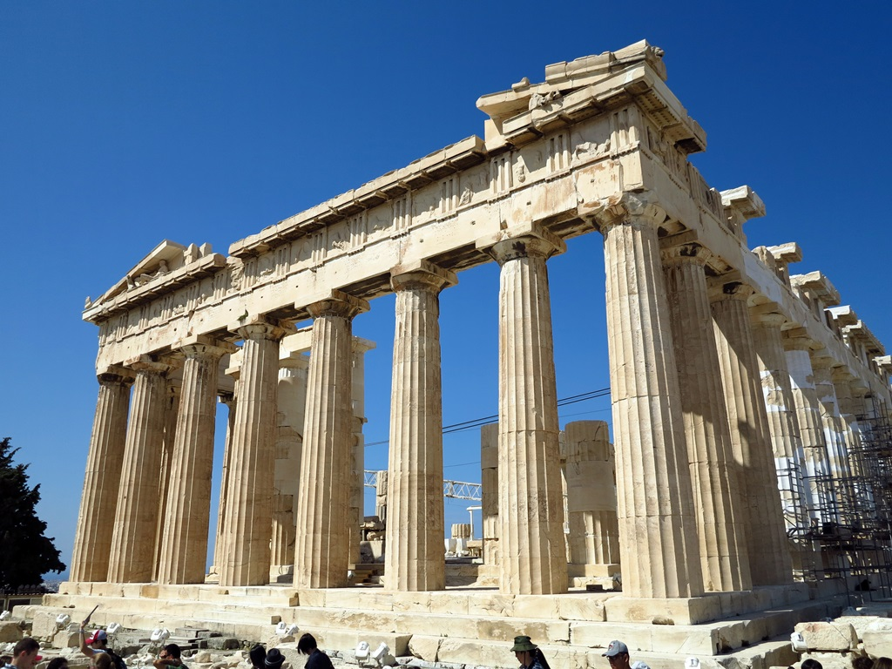
The Two Great God of the Earth
Members:
10442009 李芷容、 10442023 鄭雅文
10442025 孔祥怡、 10442041 關可汶
10532003 許筠翎、10532008 張語珈
10532026 黃子耘、10534023 陳巧妮

Slide 2


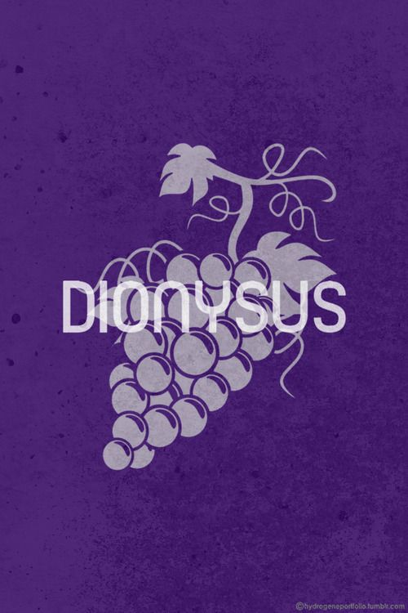
The Two Great God of the Earth

Slide 3
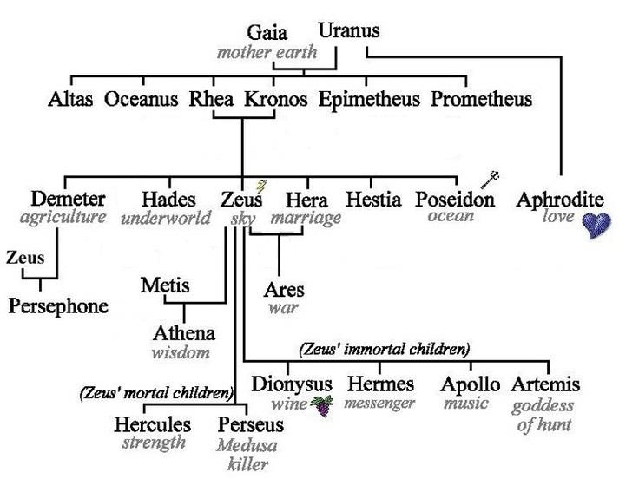
Notes:
Demeter is …
Dionysus is …

Slide 4
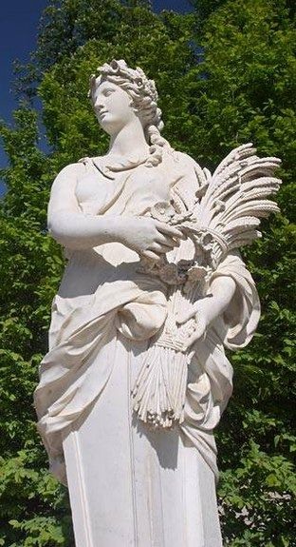
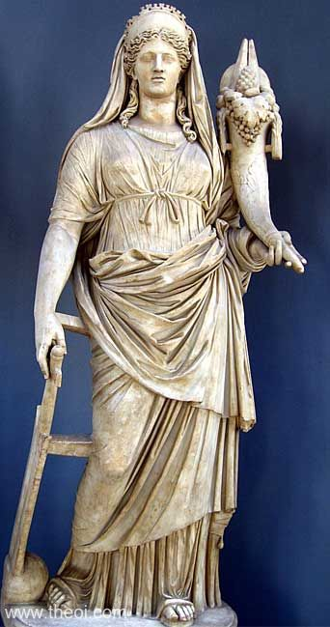
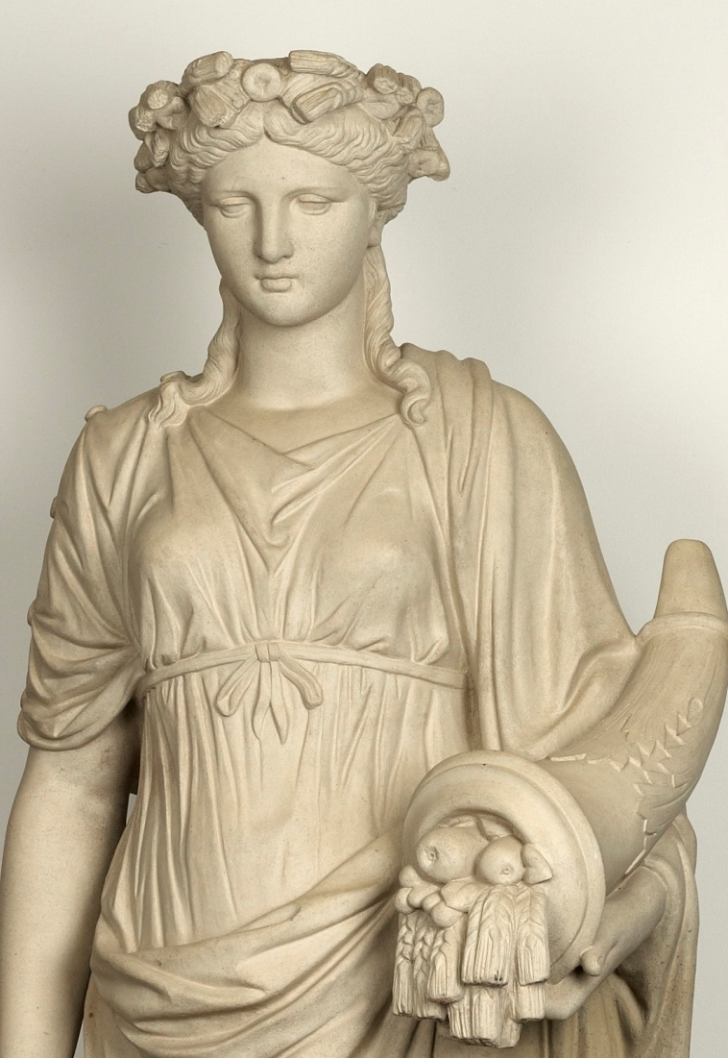
Demeter (Ceres)
Goddess of the corn, harvest and agriculture
穀類
cereal, grain, corn

Slide 5
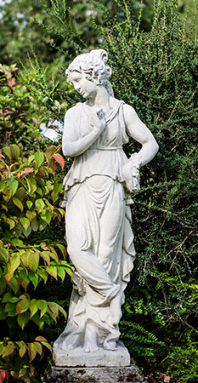
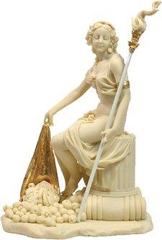
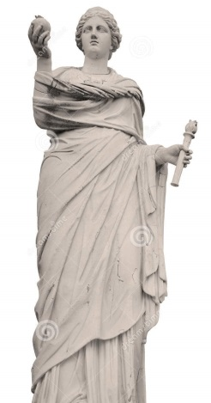
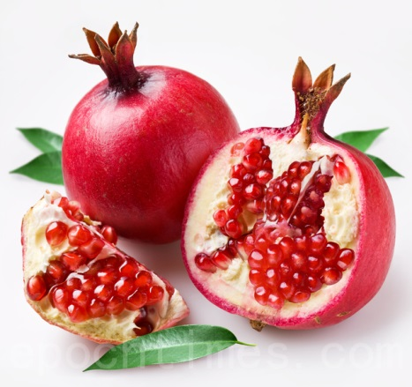
Persephone (Kore)
Goddess of the underworld, springtime,
flowers and vegetation
石榴 pomegranate
火炬 torch
Notes:
Pomegranate has a lot of ruby-like seeds, its symbol of wealth and many descendants.

Slide 6
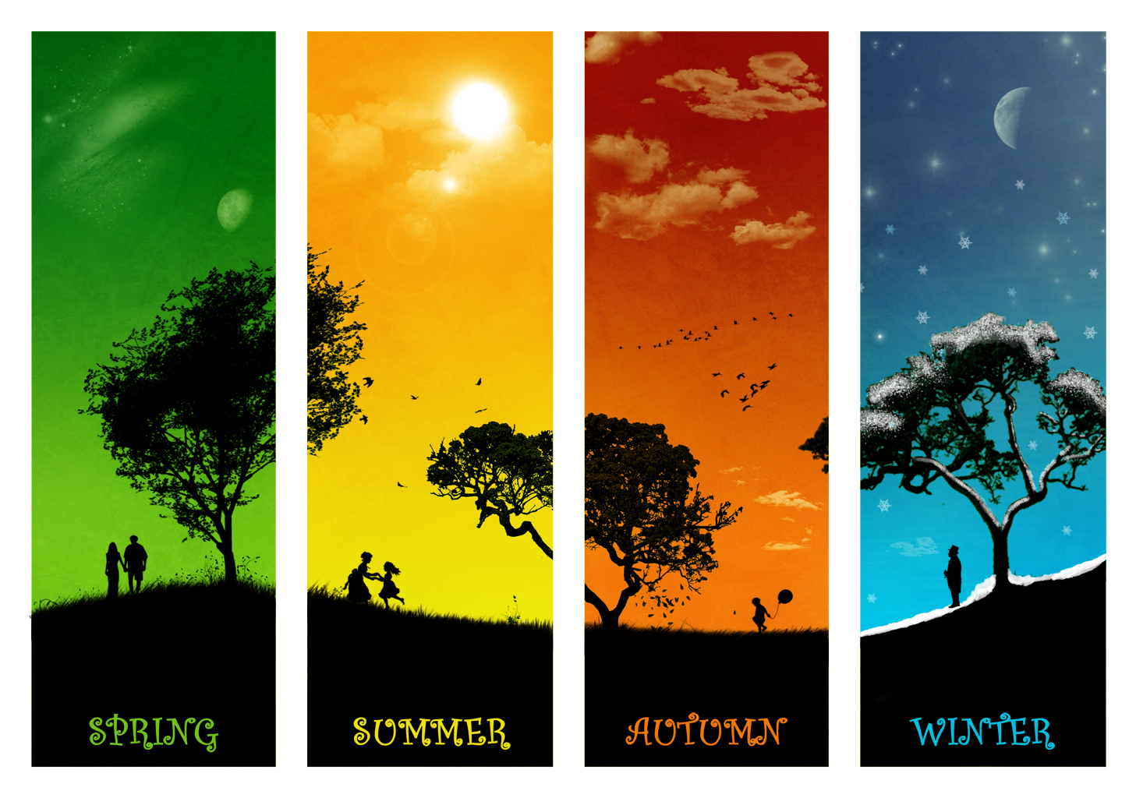
Why we have 4 season ?
Notes:
We all know that the reason of seasons change is because of the earth turns, but the ancient people have their own way of understanding.

Slide 7
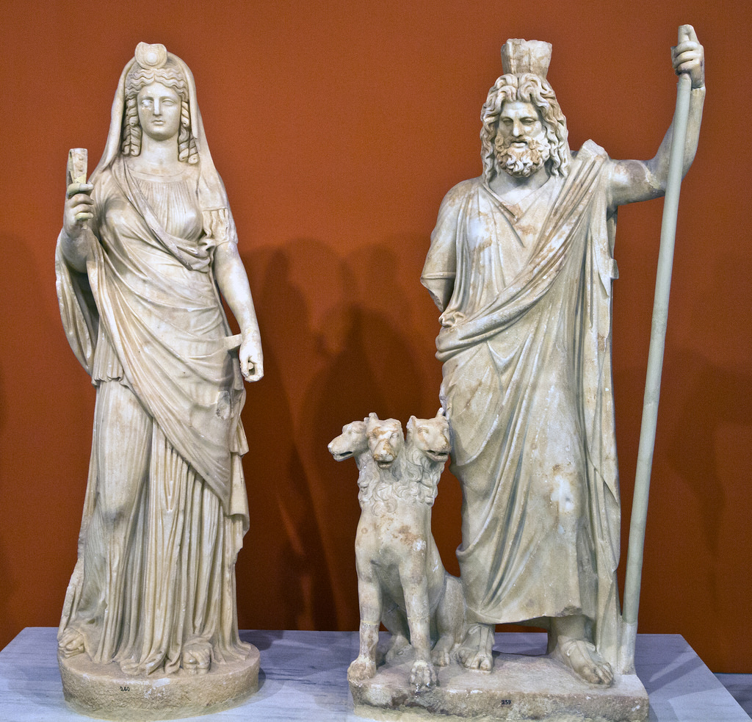
Persephone and Hades
The season was divided into four is related Persephone and Hades.
Notes:
The season was divided into four is related to Demeter’s daughter – Persephone.

Slide 8
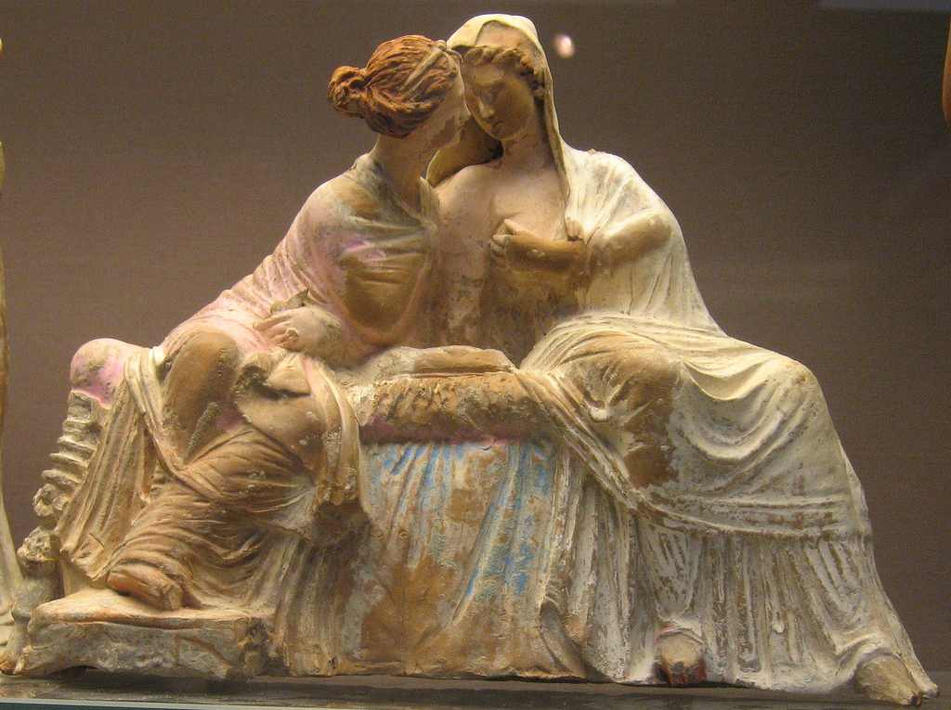
Demeter and Persephone
Persephone is the only daughter of Demeter.
Notes:
She’s the only daughter of Demeter.
One day, Demeter found that her daughter was missing.
She looked around the world but found nothing.
Demeter was so sad that anywhere she walked pass became frozen, and full of lifeless.
Because of it, the world came into disaster.
As for where Persephone is, she was caught by the king of the underworld who named Hades.
He bore her away weeping, down to the underworld.

Slide 9
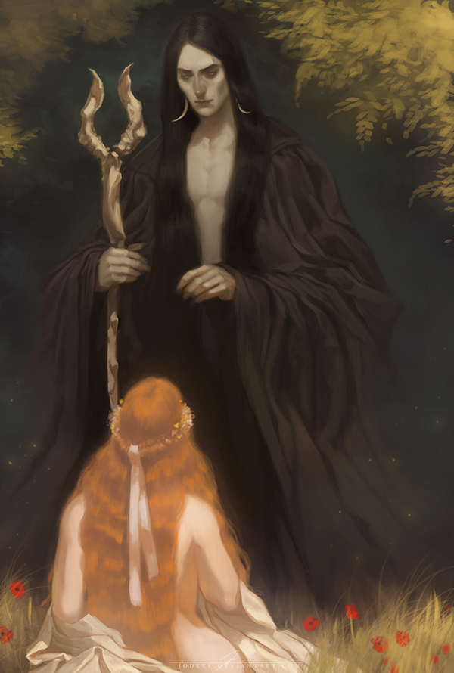
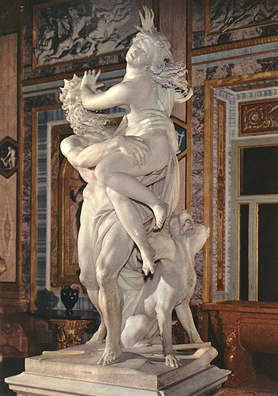
Persephone and Hades

Slide 10
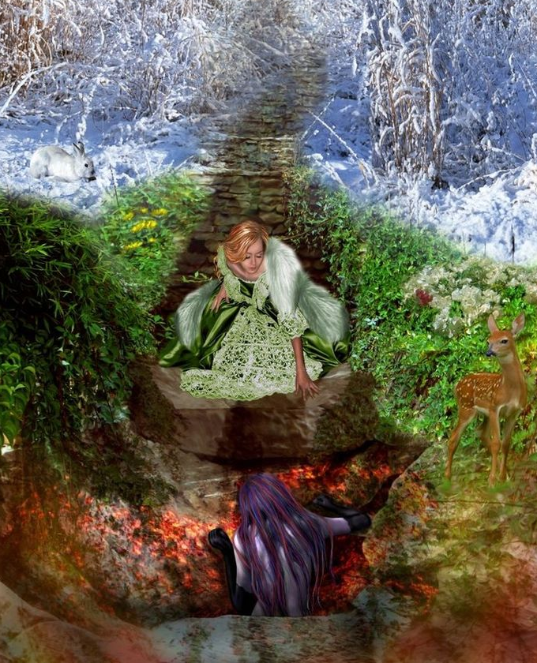
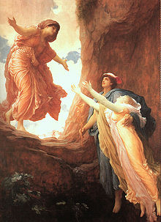
Demeter and Persephone
Notes:
Persephone’s crying echoed the hills and the sea.
Demeter heard that and then she sped over the sea and land seeking her daughter.
But no one tell her the truth last she came to the Sun that she knew where Persephone is.

Slide 11
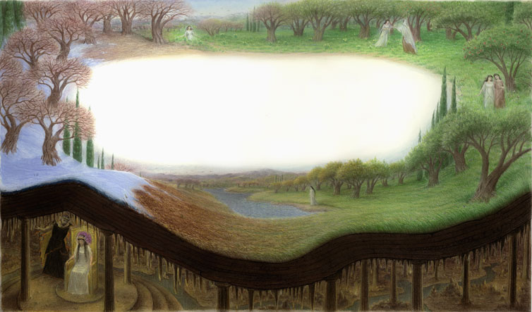
Why we have 4 season ?
Persephone will be allowed to live with her mother on earth but for the other eight months of the year, one month for every seed she ate, she will be forced to live in the underworld with Hades.

Slide 12
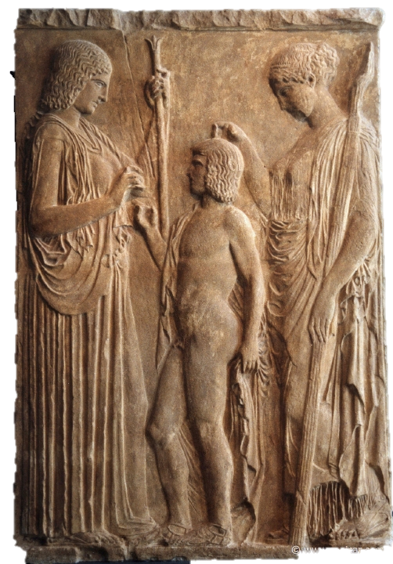
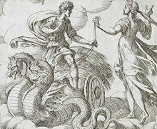
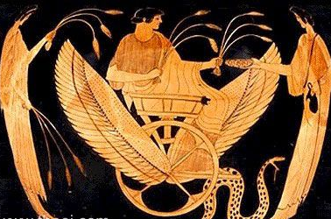
Princes of Eleusis
Celes + Metaneira
daughter
daughter
daughter
daughter
Triptolemus
Demophon
Triptolemus
Demeter’s ambassador to men
Triptolemus
Demeter
Persephone
Notes:
Triptolemus

Slide 13
Princes of Eleusis-2
Demophoon (P.50 – P.52)
Demeter nursed Demophoon.
Anointed him with ambrosia.
Place him in red heart of the fire at night .
To give immortal youth.
Version 1
The Interrupted ritual caused the baby die.
Version 2 (From Hymn 242 ff.)
Demeter gave up the plan to give him immortal youth.

Slide 14
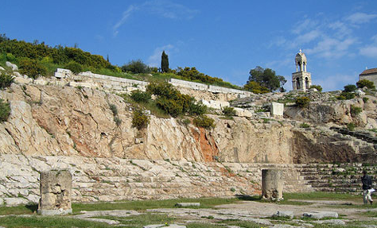
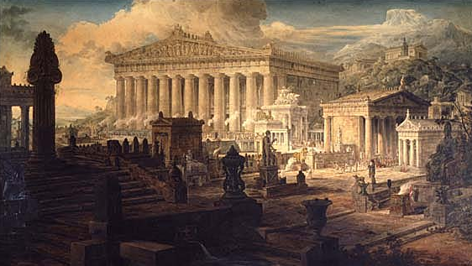
Eleusis
The origin of the mythology of Demeter and Persephone
The birthplace of the Eleusinian mysteries.
Goddess Demeter lost her daughter Persephone lonely wandering.
Notes:
《Temple of Ceres at Eleusis》
This painting by Joseph Gandy, British artist and visionary architect, gives us his idea of what the site at Eleusis might have looked like around 200CE at the beginnings of the end of the Roman Empire.

Slide 15
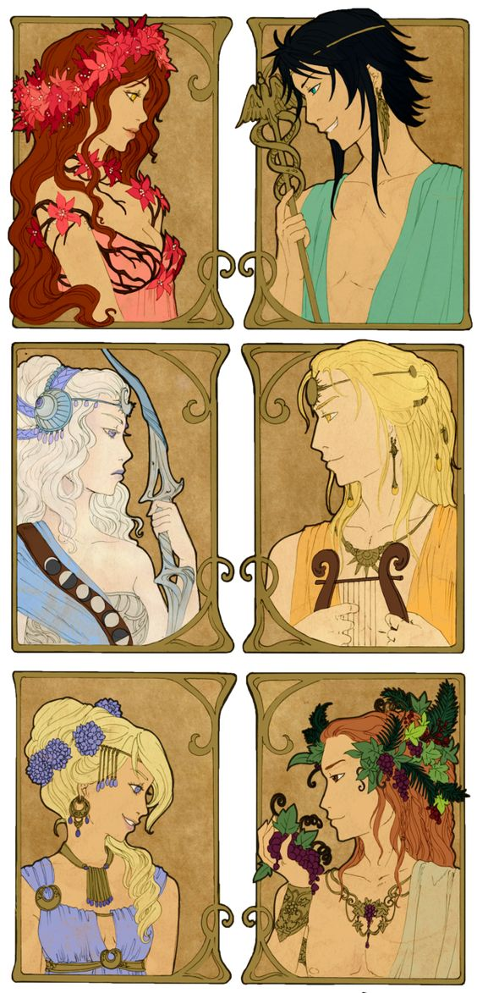
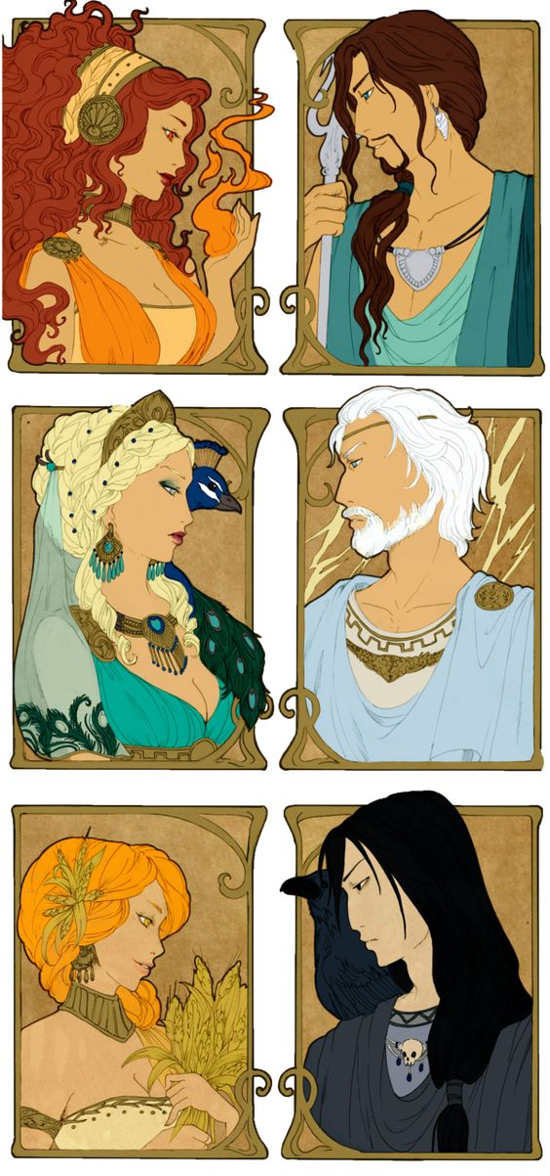

Slide 16
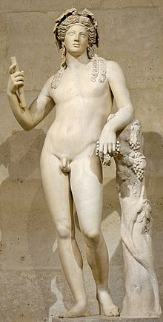
DIONYSUS (BACCHUS) 酒神 戴歐尼修斯
He was the god of the grape harvest, winemaking and wine, ritual madness and ecstasy in Greek mythology.
He was the son of Zeus and the princess Semele of Thebes.
He was the only god whose parents were not both divine.

Slide 17
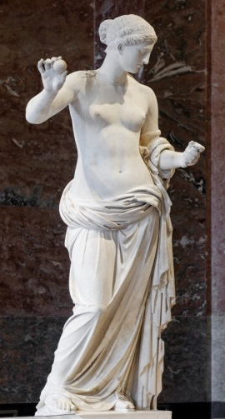
Semele (DIONYSUS’s mother)
Semele was the most unfortunate woman of all those Zeus fell in love with.
In her case too the reason was Hera.
Semele told Zeus that what she wanted see him in his full splendor as King of Heaven and Lord of the Thunderbolt.
It was Hera who had put that wish into her heart.

Slide 18
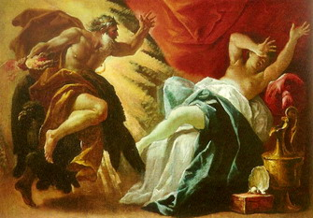
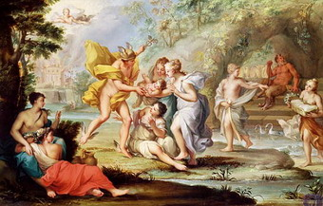
Semele

Slide 19
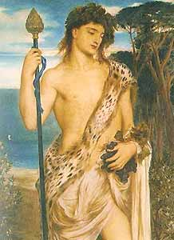
DIONYSUS
Grown to manhood, Dionysus wandered far to strange places
He taught everywhere they accepted him as a god until he drew near to his own country
the culture of the vine
the mysteries of his worship

Slide 20
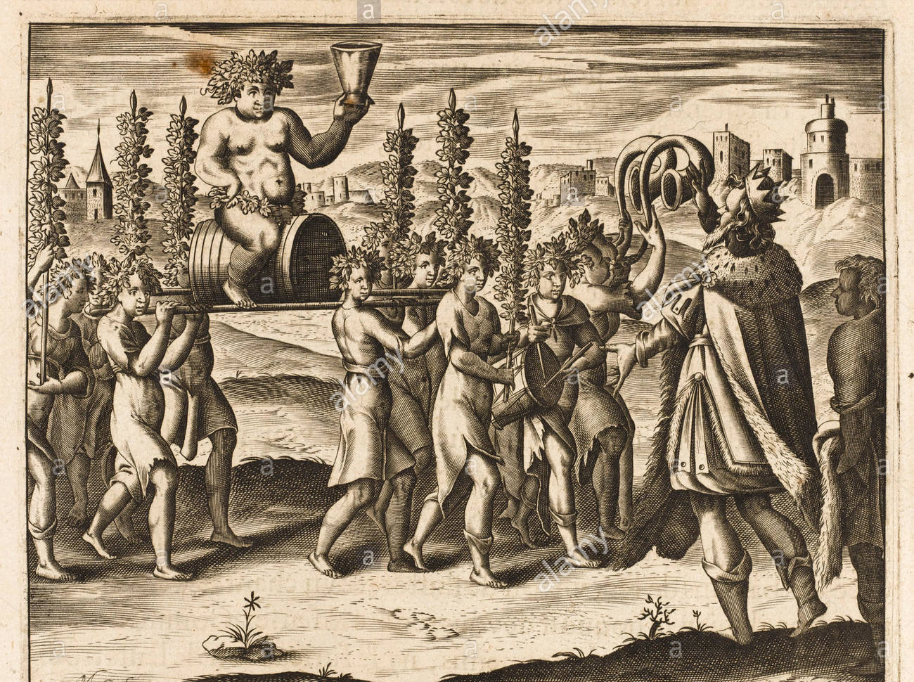
Pentheus (彭透斯/底比斯君主)
The son of Semele’s sister (侄子)
He was highly disagreed with the wild dancing and the loud joyous singing behavior of these strangers, and to be stopped at once.

Slide 21
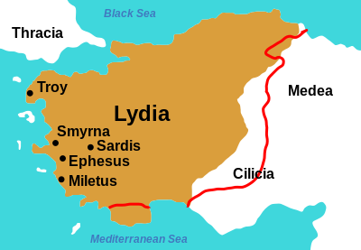
He heard a warning:
“The man you reject is a new god. He is Semele’s child, whom Zeus rescued. He, with divine Demeter, is greatest upon earth for men.”

Slide 22
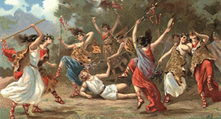
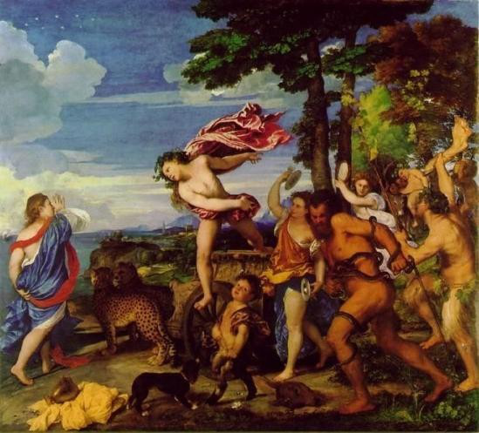

Slide 23
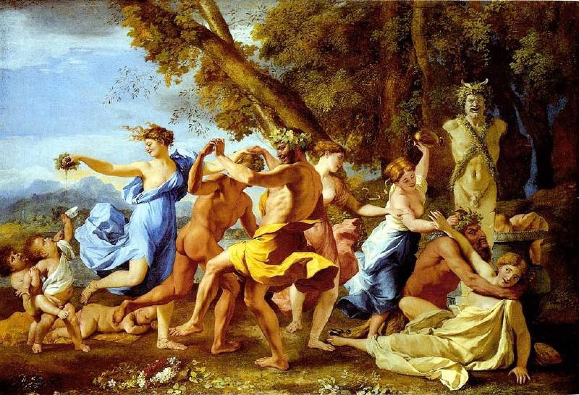
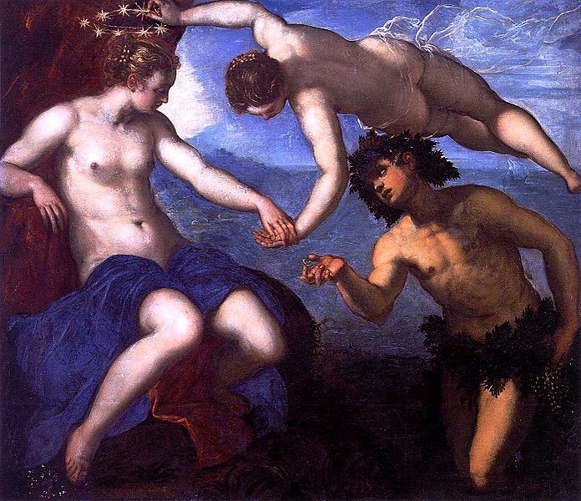
Dionysus’s anger
Dionysus made them all mad.
Pentheus finally know that he had fought against a god and must pay with his life.
The maidens are all sobered now, the dancing over and the singing and the wild wand-waving.

Slide 24
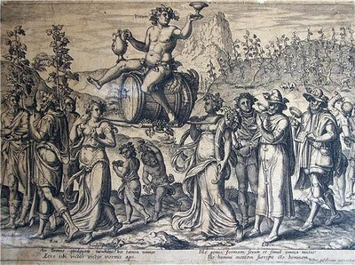
The festival for Dionysus
The festival for Dionysus was held in the spring
All participants, writers, actors, spectators, were regarded as sacred servants of Dionysus during the festival.

Slide 25
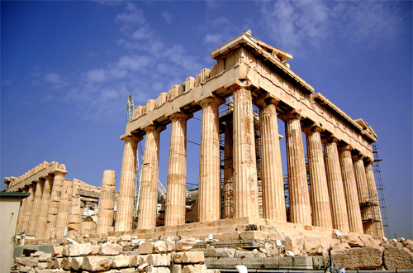
The festival for Dionysus
One was rebirth after death ;
The dismemberment by the Titans and his return to life
Echoed with viticulture, where the vines must be pruned back sharply, and then become dormant in winter for them to bear fruit. (葡萄栽培 - 修剪>沉澱>結果)

Slide 26
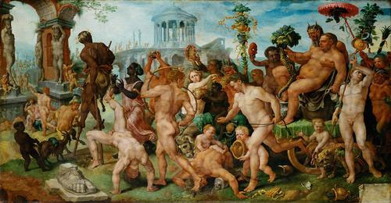
The God of Wine
The worship of Dionysus was centered in these two ideas
Freedom , Ecstatic joy
Savage brutality

Slide 27
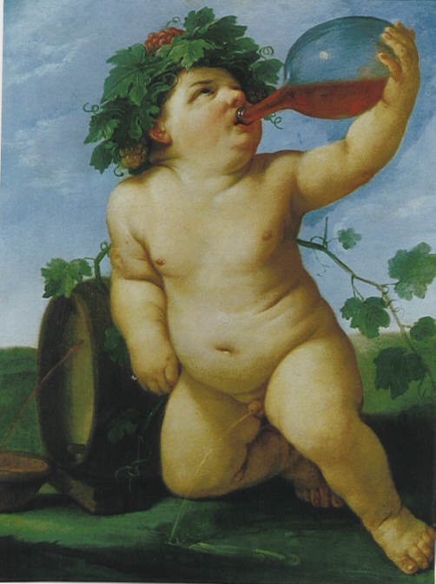
Conclusion
Dionysus was so different because of this double nature of wine and so of the god of wine.
He was man’s benefactor and he was man’s destroyer.

Slide 28
Reference
希臘神話中的植物世界
塞斯摩弗洛斯節 Thesmophoria
Symbolic Minimalist Illustrations Of The Twelve Olympians
Wikipedia

Slide 29
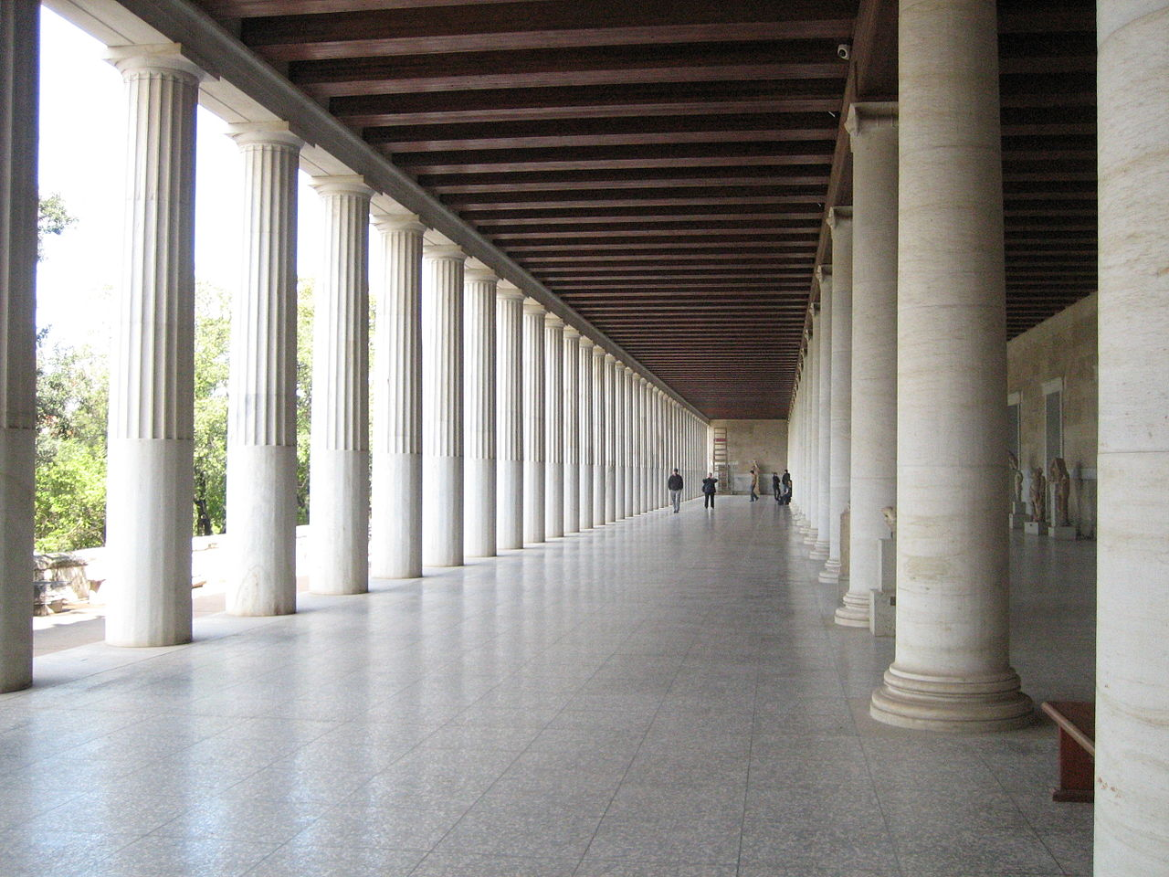
Thanks for listening!

